Slide 1
Constructor Injection with Map<Key, Value>
http://www.programmingshifts.com/

Slide 2
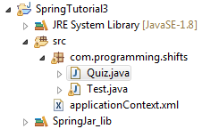
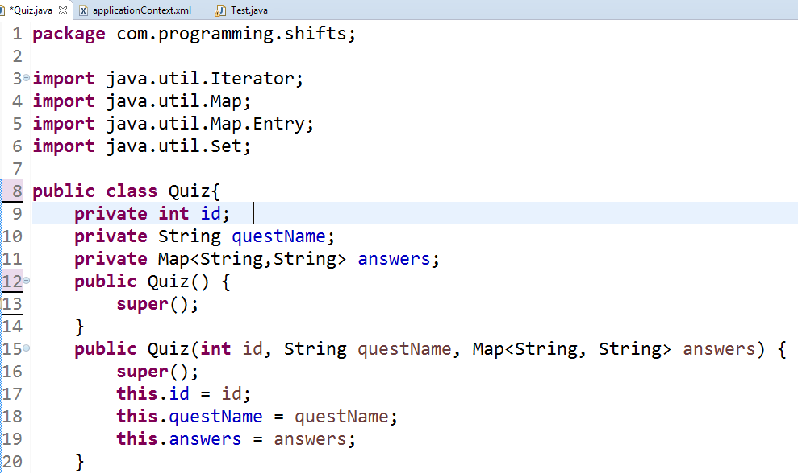
Structure and model class

Slide 3
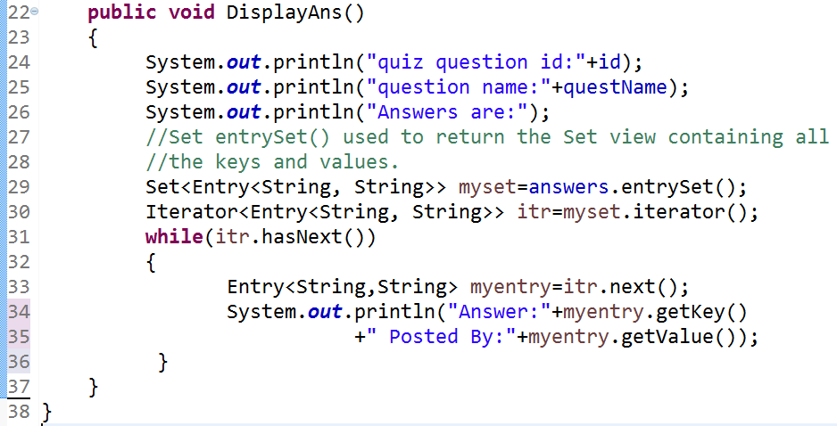
Create a method in Quiz class

Slide 4
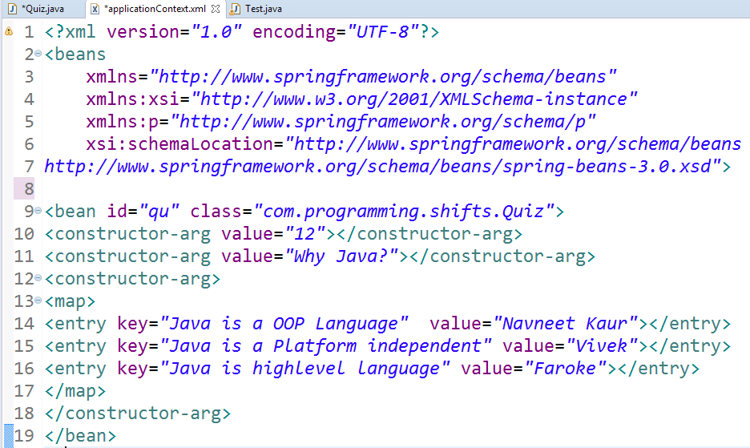
ApplicationContext.xml

Slide 5
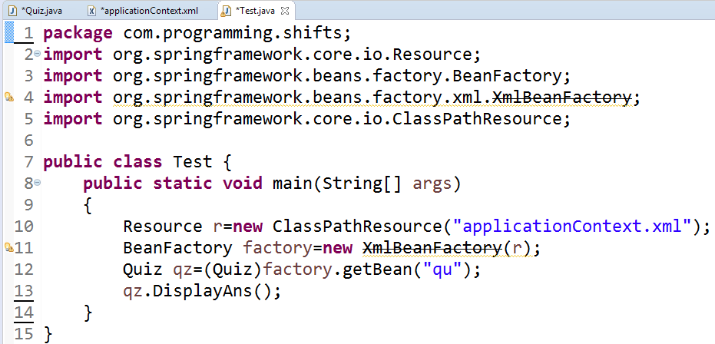
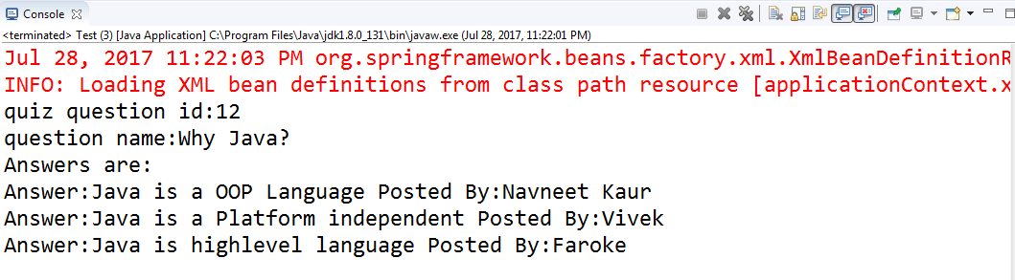
Run the Test Class

